Slide 1

Hotelier since 1979

Slide 2

Anesis Hotel Sustainable Policy
Our aims:
Energy & Water Management
Waste Management
Promotion of Responsible Tourism in the area
Donations and charity
Healthy and Sustainable Employment

Slide 3
OCCUPATIONAL HEALTH AND SAFETY POLICY
The Management of ANESIS HOTEL will comply with all of its legal duties in pursuance of providing safe and healthy working conditions for all employees and a safe and healthy environment for its customers.
In addition the Management will co-operate with all with an interest in health and safety, tourist agents, suppliers, sub-contractors and the enforcing authorities.
The hotel Management is committed to maintain and implement an Occupational Health and Safety Management System which is in accordance with the International Standard OHSAS 18001:2007.

Slide 4
OCCUPATIONAL HEALTH AND SAFETY POLICY
Heads of departments are committed to ensure that safe working practices are being carried out in their departments.
For this purpose a health and safety Committee has been formed.
The Management will ensure that all personnel is competent to carry out
their duties, and will provide all information, instruction, supervision and necessary training.
The assurance of a health and safety work environment is been achieved by encouraging all personnel to participate in OH&S activities.
This policy will be kept up to date and will be amended to suit any changes in the size or nature of hotel’s activities. In support of this intent the policy will be reviewed annually.

Slide 5
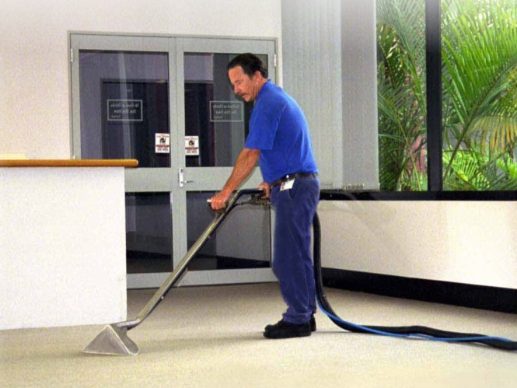

Purchasing & Services
Our main objective when we buy supplies and services is to give priority to the local area and region. 65 % of our supplies and services come from Famagusta area.
Every time when we buy products and services we take into consideration the following:
Made from Recycled products or are recyclable
Sustainably produced/ sourced
Energy efficient and water saving
Environmental sustainable

Slide 6
Employees
Anesis Hotel has 62 % of local employees and 38 % foreign employees.
Gender 38% male and 62% female.
We make sure that all our employees receive the appropriate training in order give the appropriate attention to our customers.
We focus on team work which is the most successful way to achieve our goals.

Slide 7

Work Ethics
Hotel Industry it’s all about team work
In Anesis Hotel we work as a team and helping each other to achieve a common goal.
We strive to deliver good quality service to our guests and also to improve our skills and learn new things concerning the work environment.
We assist everyone despite gender, age, race, nationality and religious believes, education, social status, disability, appearance, sexual orientation.

Slide 8
Statement of Commitment to Human Rights
At Anesis Hotel we strive to provide a safe workplace where the human rights are respected in accordance with the collective agreements with the unions and the applicable legislation.
We are an equal opportunity employer and we support the protection of human rights, particularly those of our employees, the parties we do business with and the community where we operate.
In particular, our hotel is committed to the following:
Respect and foster labor-related human rights, including non-discrimination, health & safety and fair wages.
All new employees are informed before they start work about the terms and conditions of their employment, including pay and welfare arrangements.
We prohibit hiring of young workers (below 18 years of age) to perform any type of work that is likely to jeopardize their health, safety or morals.
Respect children’s rights and have zero tolerance of violence, any form of exploitation and abuse of children, including but not limited to sexual exploitation.
All allegations of children exploitation will be taken seriously and investigated. Serious allegations will be reported to the relevant authorities.
Communicate both internally and externally the risks related to children’s rights.
All staff working with children receives regular, ongoing training.
We expect that all hotel employees, suppliers and other business partners will respect human rights including children’s rights.

Slide 9
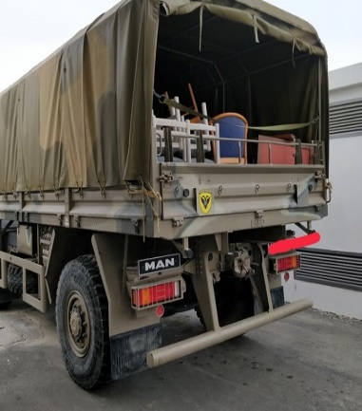
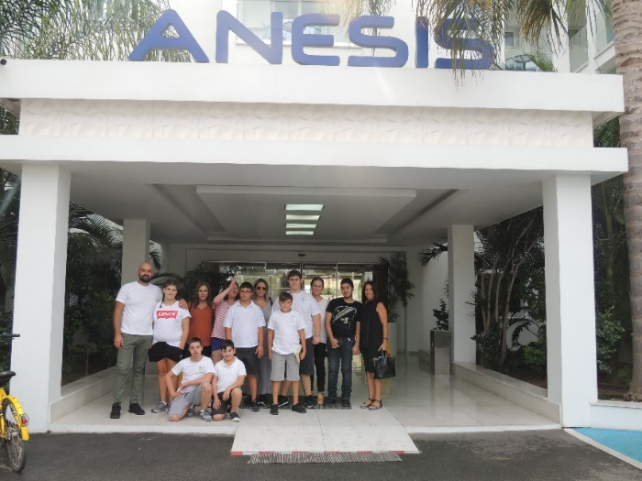

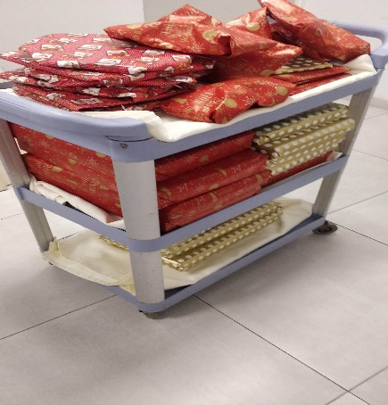
Donations / Contribution to local community
Every year Anesis Hotel is donating money or other supplies to various institution, schools, army bases and other centers who supports kids with special abilities as well as local festivals.
Year Donations
2017 = 60 %
2018 = 20 %
2019 = 70 %
2020 = 0 %
2021 = 10%
2022 = 70%
2023 = 20%

Slide 10
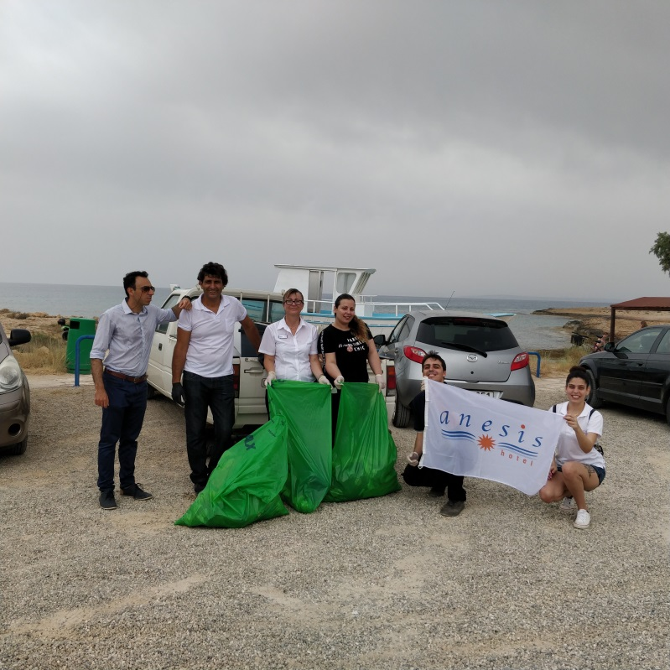
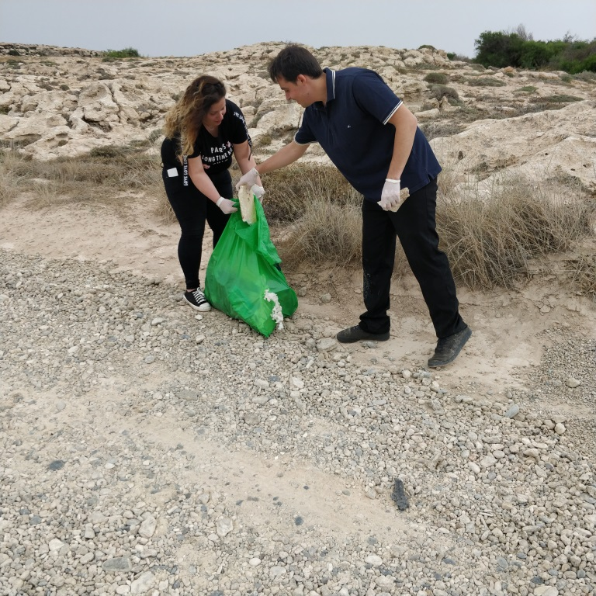

Donations / Contribution to local community
Anesis Hotel staff cleaning Ammos tou Kampouri Beach

Slide 11


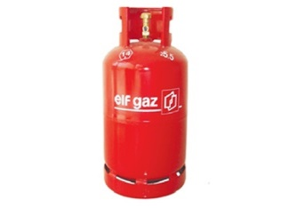
Energy Consumption
Electricity (kW per guest night)
2021 = 5.37 2022= 6.90 2023 = 6.26
Petrol (kWh per guest night)
2021 = 0.86 2022= 4.18 2023 = 2.81
Gas (kWh per guest night)
2021 = 0.59 2022= 0.80 2023 = 0.72
2021 HOTEL OPERATED FOR 6 MONTHS
2022 HOTEL OPERATED FOR 8 MONTHS
2023 HOTEL OPERATED FOR 10 MONTHS

Slide 12
Water Consumption
Water (Liters per guest night)
2021 = 1.45 m3 / 2022 = 1.65 m3 / 2023 = 1.76 m3
2021 HOTEL OPERATED FOR 6 MONTHS
2022 HOTEL OPERATED FOR 8 MONTHS
2023 HOTEL OPERATED FOR 10 MONTHS

Slide 13

Products that we recycle in the hotel.
Glass

Slide 14

Products that we recycle in the hotel.
Plastic

Slide 15

Products that we recycle in the hotel.
Paper

Slide 16

Ink/ Toner
2013 = 20 kg reduced carbon
2014 = 22 kg reduced carbon
2015 = 14 kg reduced carbon
2016 = 23 kg reduced carbon
2017= 35 kg reduced carbon
2019 = 32 kg reduced carbon
2021 = 37 kg reduced carbon
2022 = WE DO NOT USED ink cartridges

Slide 17

Disposal lightbulbs
In all area of the hotel we use led bulbs that save energy.
2022 = 30 kg
2023 = 20 kg

Slide 18
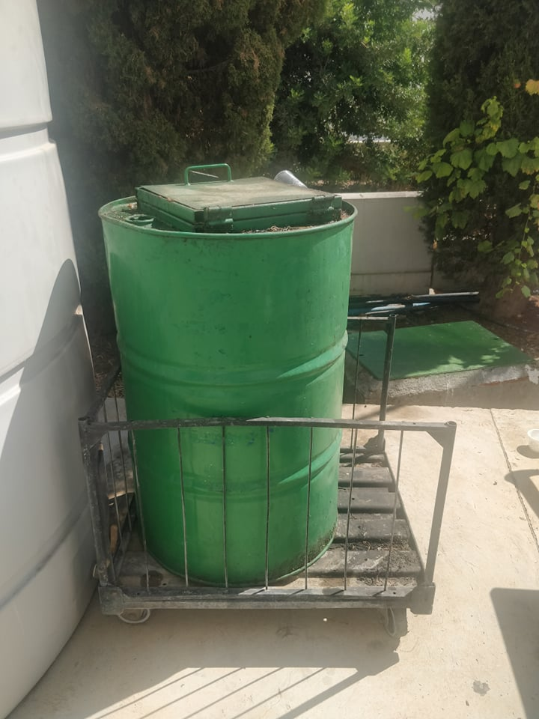

Cooked Oil

Slide 19

Batteries
2013 = 20 kg
2014 = 5 kg
2017 = 25 kg
2022 = 14 kg
2023 = 45 kg

Slide 20
Dear valued guest
Water has become very precious especially for Cyprus
Please decide for yourself
A towel on ‘’rack means…. I’ll use it again’’
A towel on ‘’the floor means…. Please replace’’
Thank you very much

Slide 21
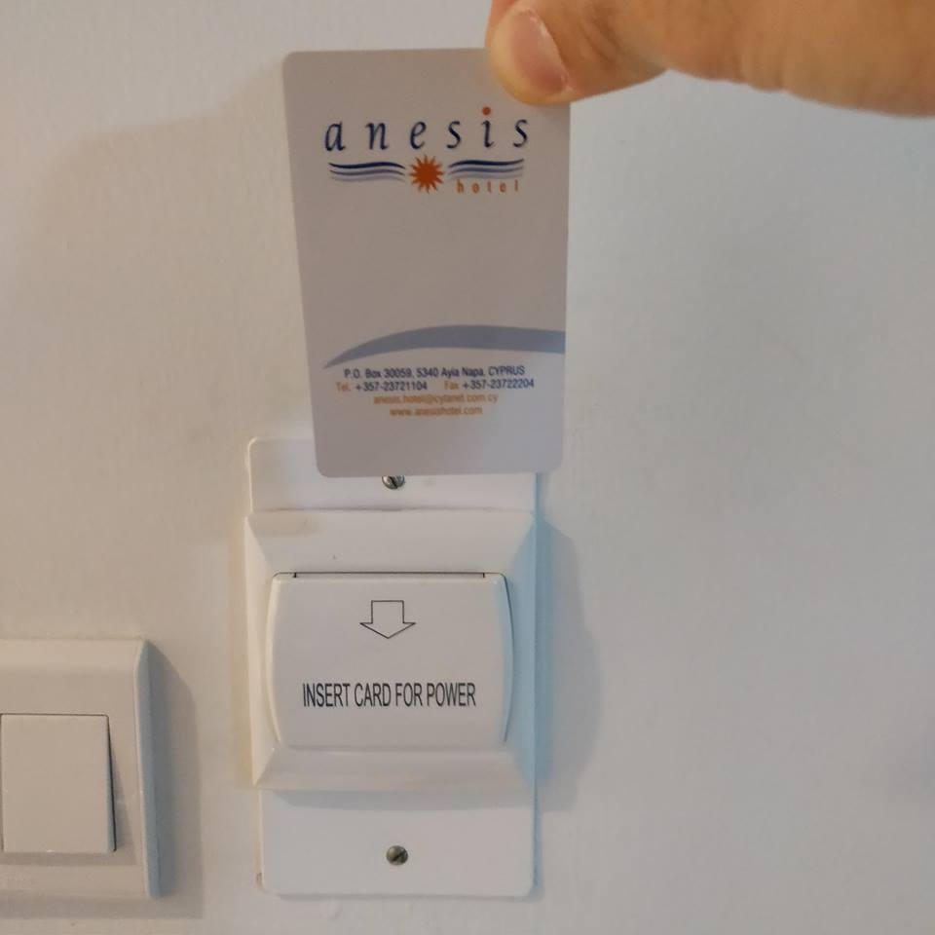
Dear valued guest
Every time that you leave your room do not forget to take with you, your room card.
Thank you for your cooperation

Slide 22

Dear valued guest
Use water responsibly. Every drop counts
Thank you for your cooperation

Slide 23
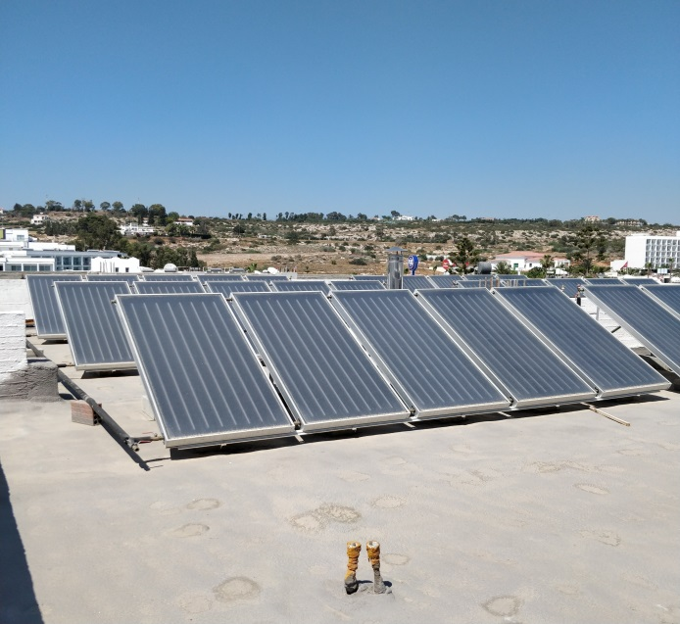
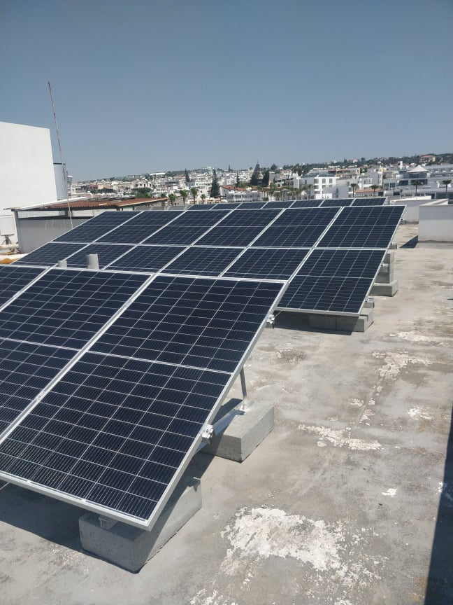
In Anesis Hotel we use solar panels and photovoltaic panels to heat the water and energy consumption
And we are classified as a category B hotel

Slide 24

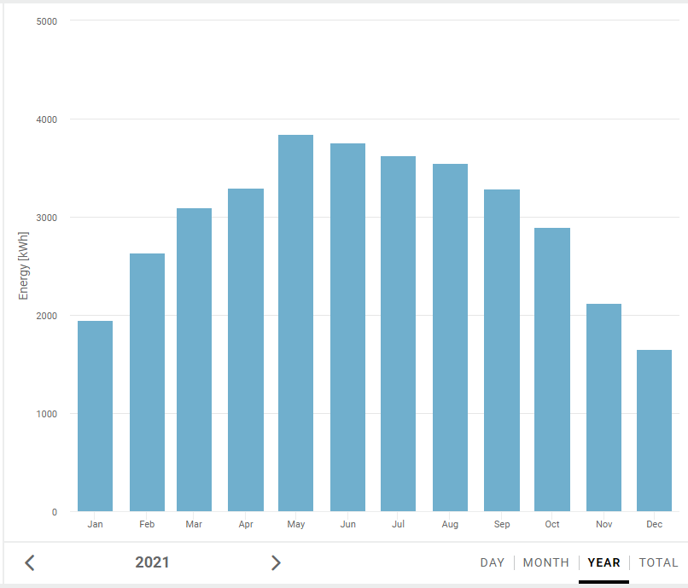
Energy production
from photovoltaic panels

Slide 25

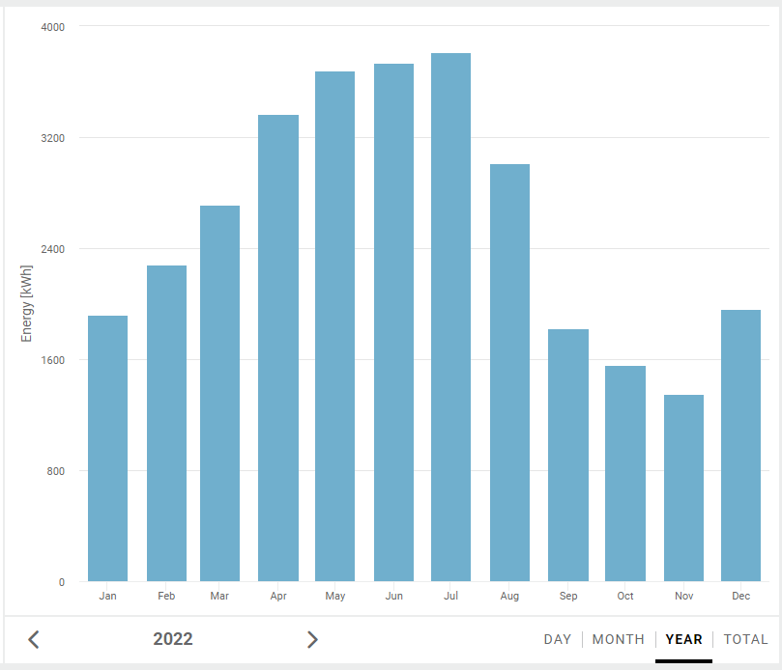
Energy production
from photovoltaic panels

Slide 26

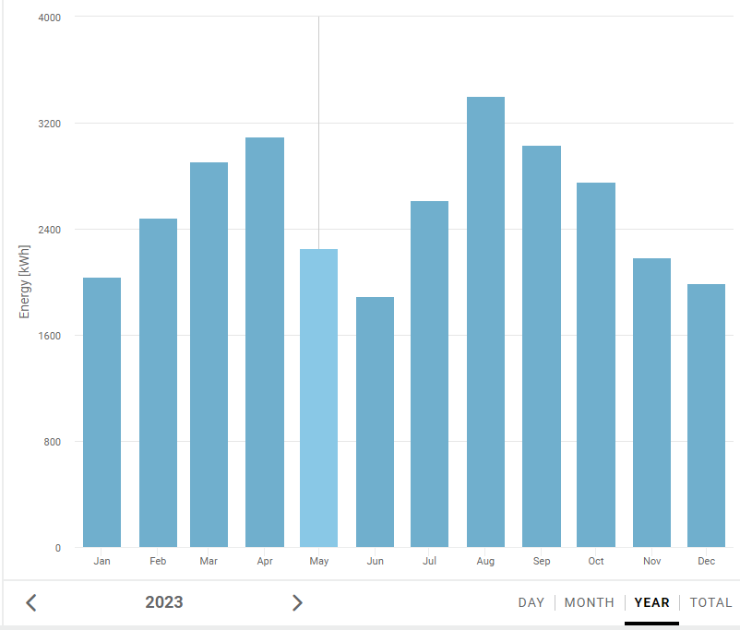
Energy production
from photovoltaic panels

Slide 27
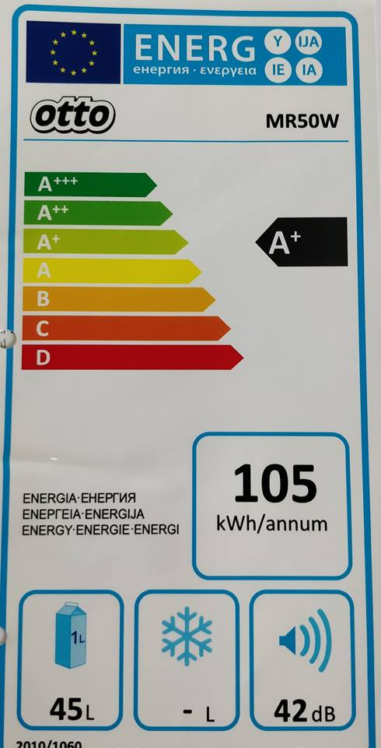
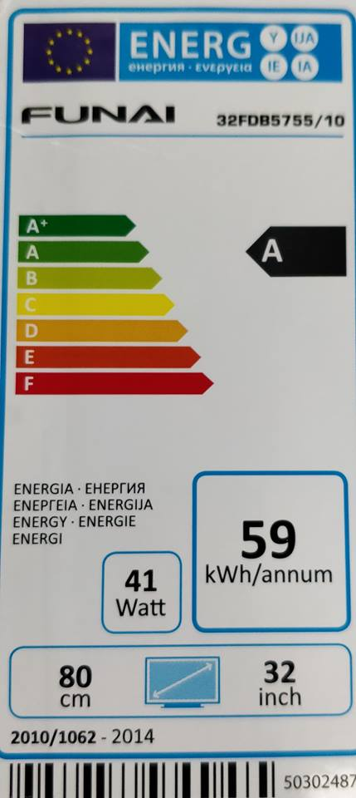
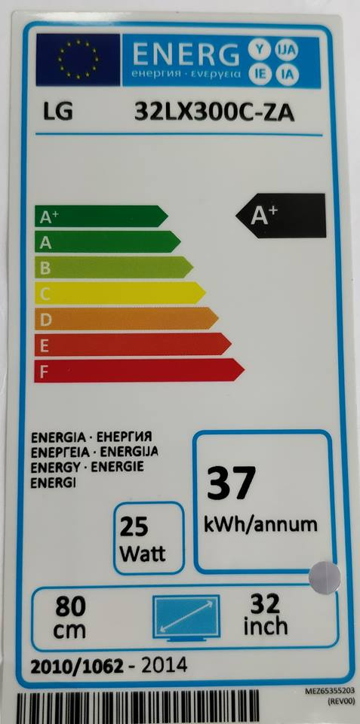
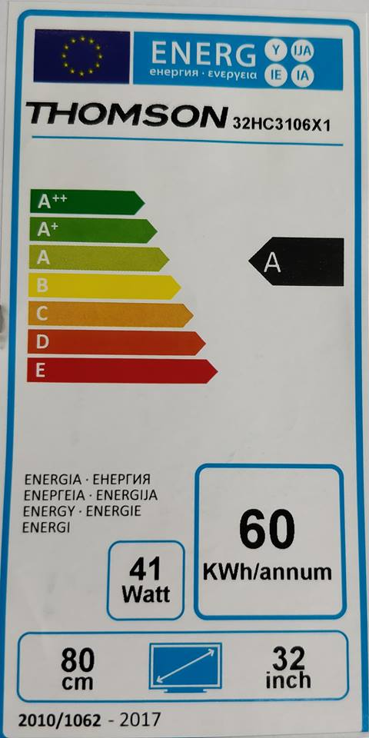
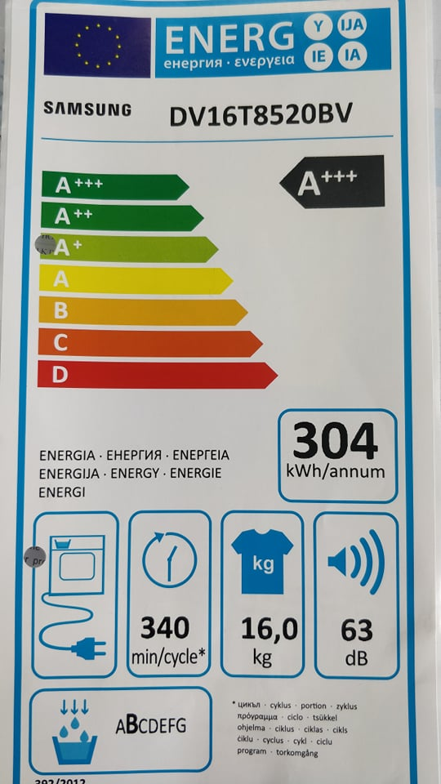
TV, FRIDGES & LAUNDRY MACHINES
All our televisions, fridges & laundry machines use A , A+, A+++ ENERGY EFFICIENCY

Slide 28
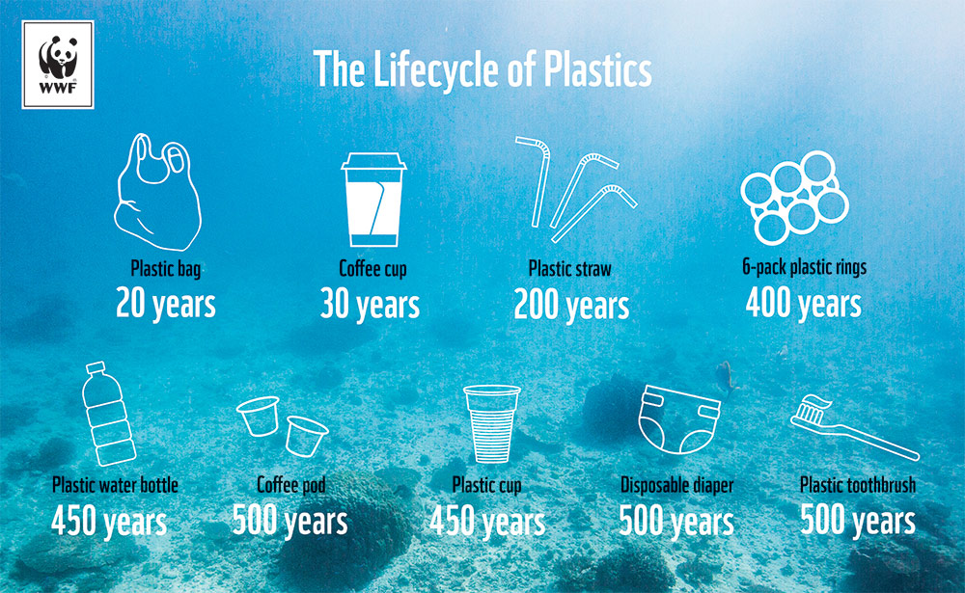

Slide 29


Slide 30
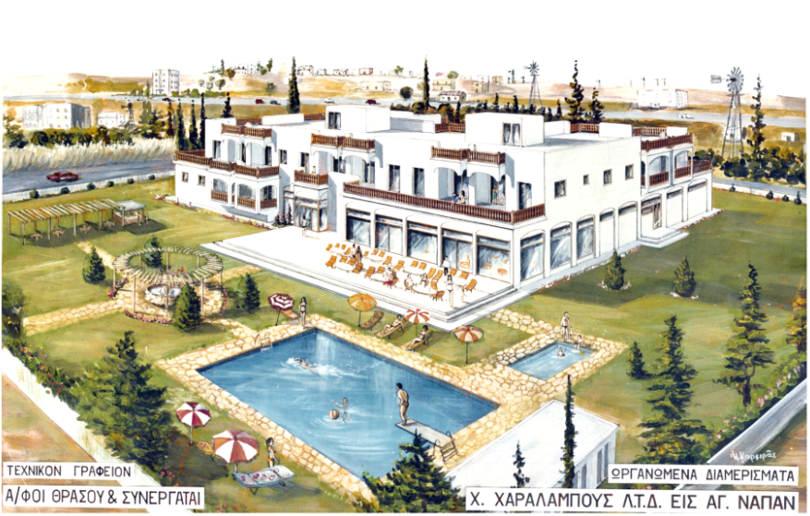
Year 1979

Slide 31

NOTICE
FIRE ALARM TEST
Please be advised that the Fire Alarm in these premises will be tested the last Thursday of every month at 11:00 a.m.
The alarm will be activated for a short period of time.
If you are in the premises at the time of the test, please notify Reception if you do not hear the alarm whilst in your room or specific location.
The Management

Slide 32
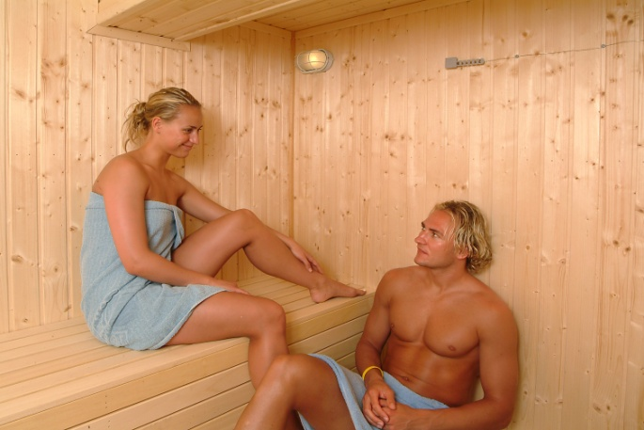
SAUNA
САУНА
TIME
10:00 - 18:00
€6.00
30 min

Slide 33
Thank you

